Slide 1
Introduction to Principal Component Analysis

Slide 2
Outline
What is Principal Component Analysis?
Real world example using PCA
Principal Components
Scree Plot
Loading Scores

Slide 3

What makes a person live longer?

Slide 4
 | Lifespan | Height | Weight | Average Blood Pressure | Average Heart Rate | BMI | Cholesterol Levels | Average Cigarettes per day | Sugar Level
Person 1 | 82 | 150 | 80 | 140/90 | 63 | 36 | 5.0 | 0 | 99
Person 2 | 73 | 174 | 90 | 90/60 | 100 | 32 | 4.1 | 0 | 95
Person 3 | 95 | 183 | 109 | 120/80 | 95 | 29 | 3.6 | 1 | 92
Person 4 | 92 | 186 | 95 | 12/75 | 84 | 28 | 4.8 | 5 | 89
Person 5 | 92 | 170 | 67 | 95/60 | 76 | 23 | 2.7 | 10 | 100
Person 6 | 65 | 180 | 82 | 92/60 | 78 | 25 | 3.7 | 10 | 112
Person 7 | 93 | 165 | 71 | 124/80 | 81 | 26 | 3.8 | 0 | 113
… | … | … | … | … | … | … | … | … | …
Person 8 | 80 | 172 | 70 | 97/70 | 90 | 24 | 3.4 | 0 | 100
Imagine we have a dataset that contains the lifespan of each person according to the following eight factors

Slide 5
 | Lifespan | Height | Weight | Average Blood Pressure | Average Heart Rate | BMI | Cholesterol Levels | Average Cigarettes per day | Sugar Level
Person 1 | 82 | 150 | 80 | 140/90 | 63 | 36 | 5.0 | 0 | 99
Person 2 | 73 | 174 | 90 | 90/60 | 100 | 32 | 4.1 | 0 | 95
Person 3 | 95 | 183 | 109 | 120/80 | 95 | 29 | 3.6 | 1 | 92
Person 4 | 92 | 186 | 95 | 12/75 | 84 | 28 | 4.8 | 5 | 89
Person 5 | 92 | 170 | 67 | 95/60 | 76 | 23 | 2.7 | 10 | 100
Person 6 | 65 | 180 | 82 | 92/60 | 78 | 25 | 3.7 | 10 | 112
Person 7 | 93 | 165 | 71 | 124/80 | 81 | 26 | 3.8 | 0 | 113
… | … | … | … | … | … | … | … | … | …
Person 8 | 80 | 172 | 70 | 97/70 | 90 | 24 | 3.4 | 0 | 100
In order to analyze and draw conclusions from this data

Slide 6
 | Lifespan | Height | Weight | Average Blood Pressure | Average Heart Rate | BMI | Cholesterol Levels | Average Cigarettes per day | Sugar Level
Person 1 | 82 | 150 | 80 | 140/90 | 63 | 36 | 5.0 | 0 | 99
Person 2 | 73 | 174 | 90 | 90/60 | 100 | 32 | 4.1 | 0 | 95
Person 3 | 95 | 183 | 109 | 120/80 | 95 | 29 | 3.6 | 1 | 92
Person 4 | 92 | 186 | 95 | 12/75 | 84 | 28 | 4.8 | 5 | 89
Person 5 | 92 | 170 | 67 | 95/60 | 76 | 23 | 2.7 | 10 | 100
Person 6 | 65 | 180 | 82 | 92/60 | 78 | 25 | 3.7 | 10 | 112
Person 7 | 93 | 165 | 71 | 124/80 | 81 | 26 | 3.8 | 0 | 113
… | … | … | … | … | … | … | … | … | …
Person 8 | 80 | 172 | 70 | 97/70 | 90 | 24 | 3.4 | 0 | 100
We need to be able to understand it or at the very least visualize it

Slide 7
 | Lifespan | Height | Weight | Average Blood Pressure | Average Heart Rate | BMI | Cholesterol Levels | Average Cigarettes per day | Sugar Level
Person 1 | 82 | 150 | 80 | 140/90 | 63 | 36 | 5.0 | 0 | 99
Person 2 | 73 | 174 | 90 | 90/60 | 100 | 32 | 4.1 | 0 | 95
Person 3 | 95 | 183 | 109 | 120/80 | 95 | 29 | 3.6 | 1 | 92
Person 4 | 92 | 186 | 95 | 12/75 | 84 | 28 | 4.8 | 5 | 89
Person 5 | 92 | 170 | 67 | 95/60 | 76 | 23 | 2.7 | 10 | 100
Person 6 | 65 | 180 | 82 | 92/60 | 78 | 25 | 3.7 | 10 | 112
Person 7 | 93 | 165 | 71 | 124/80 | 81 | 26 | 3.8 | 0 | 113
… | … | … | … | … | … | … | … | … | …
Person 8 | 80 | 172 | 70 | 97/70 | 90 | 24 | 3.4 | 0 | 100
Obviously, we cannot visualize eight dimensions all at once

Slide 8
 | Lifespan | Height | Weight | Average Blood Pressure | Average Heart Rate | BMI | Cholesterol Levels | Average Cigarettes per day | Sugar Level
Person 1 | 82 | 150 | 80 | 140/90 | 63 | 36 | 5.0 | 0 | 99
Person 2 | 73 | 174 | 90 | 90/60 | 100 | 32 | 4.1 | 0 | 95
Person 3 | 95 | 183 | 109 | 120/80 | 95 | 29 | 3.6 | 1 | 92
Person 4 | 92 | 186 | 95 | 12/75 | 84 | 28 | 4.8 | 5 | 89
Person 5 | 92 | 170 | 67 | 95/60 | 76 | 23 | 2.7 | 10 | 100
Person 6 | 65 | 180 | 82 | 92/60 | 78 | 25 | 3.7 | 10 | 112
Person 7 | 93 | 165 | 71 | 124/80 | 81 | 26 | 3.8 | 0 | 113
… | … | … | … | … | … | … | … | … | …
Person 8 | 80 | 172 | 70 | 97/70 | 90 | 24 | 3.4 | 0 | 100
But we can pick two or three factors

Slide 9
 | Lifespan | Height | Weight | Average Blood Pressure | Average Heart Rate | BMI | Cholesterol Levels | Average Cigarettes per day | Sugar Level
Person 1 | 82 | 150 | 80 | 140/90 | 63 | 36 | 5.0 | 0 | 99
Person 2 | 73 | 174 | 90 | 90/60 | 100 | 32 | 4.1 | 0 | 95
Person 3 | 95 | 183 | 109 | 120/80 | 95 | 29 | 3.6 | 1 | 92
Person 4 | 92 | 186 | 95 | 12/75 | 84 | 28 | 4.8 | 5 | 89
Person 5 | 92 | 170 | 67 | 95/60 | 76 | 23 | 2.7 | 10 | 100
Person 6 | 65 | 180 | 82 | 92/60 | 78 | 25 | 3.7 | 10 | 112
Person 7 | 93 | 165 | 71 | 124/80 | 81 | 26 | 3.8 | 0 | 113
… | … | … | … | … | … | … | … | … | …
Person 8 | 80 | 172 | 70 | 97/70 | 90 | 24 | 3.4 | 0 | 100
For example Cholesterol Levels and Average Cigarettes per day and visualize that

Slide 10

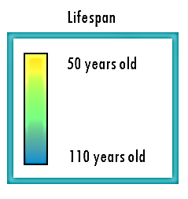



Cholesterol Level
Average cigarettes per day

Slide 11
Cholesterol Level
Average cigarettes per day
However, if we visualize it this way, we might lose some valuable information that might be contained in other factors of the data like Average Blood Pressure and Sugar Level

Slide 12

Is there a way of taking into account all factors?

Slide 13
Principal
Component
Analysis
An amazing solution is called Principal Component Analysis or PCA for short

Slide 14
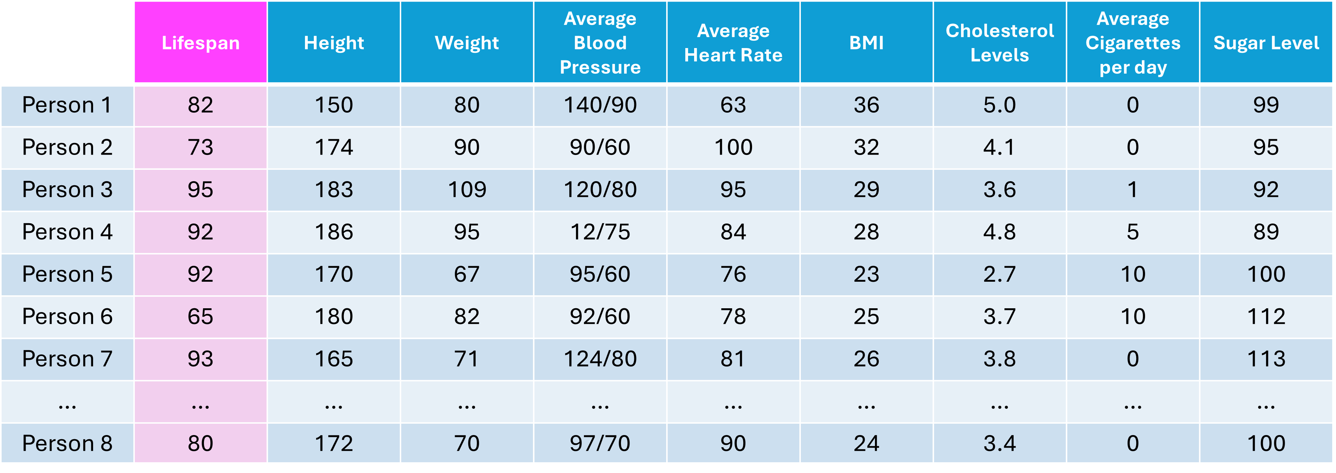
Principal
Component
Analysis
PCA takes all of the factors and combines them in a smart way

Slide 15
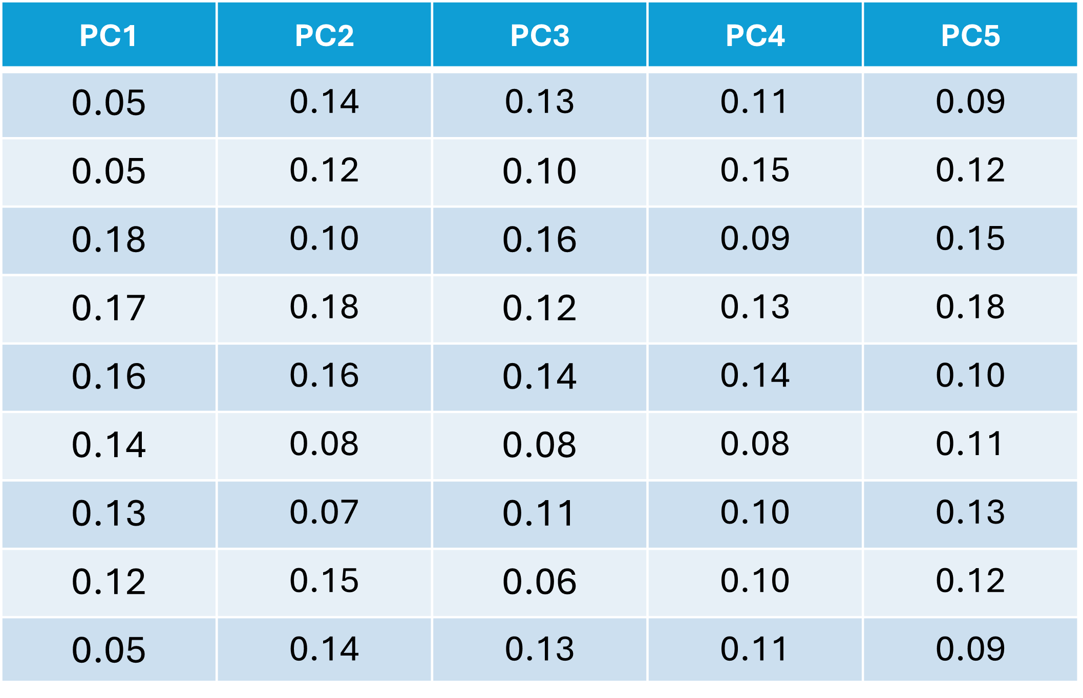
Principal
Component
Analysis
And produces new factors called principal components

Slide 16
PCA
8 factors (dimensions)
5 principal Components
Principal Component Analysis enables us to reduce our dataset with 8 factors to 5 principal components

Slide 17
PCA
8 factors (dimensions)
5 principal Components
By using PCA, we were able to simplify our data much more and what is important is we did not lose much information

Slide 18
PC1 | PC2 | PC3 | PC4 | PC5
0.05 | 0.14 | 0.13 | 0.11 | 0.09
0.05 | 0.12 | 0.10 | 0.15 | 0.12
0.18 | 0.10 | 0.16 | 0.09 | 0.15
0.17 | 0.18 | 0.12 | 0.13 | 0.18
0.16 | 0.16 | 0.14 | 0.14 | 0.10
0.14 | 0.08 | 0.08 | 0.08 | 0.11
0.13 | 0.07 | 0.11 | 0.10 | 0.13
0.12 | 0.15 | 0.06 | 0.10 | 0.12
0.05 | 0.14 | 0.13 | 0.11 | 0.09
Okay but we still cannot represent 5 dimensions to a 2 dimensional plot

Slide 19

Rank | Principal Component | % Variance Explained
1 | PC1 | 50%
2 | PC2 | 35%
3 | PC3 | 10%
4 | PC4 | 3%
5 | PC5 | 2%
The nice thing about PCA is that principal components are ranked from most important to least important

Slide 20
PC1 | PC2 | PC3 | PC4 | PC5
0.05 | 0.14 | 0.13 | 0.11 | 0.09
0.05 | 0.12 | 0.10 | 0.15 | 0.12
0.18 | 0.10 | 0.16 | 0.09 | 0.15
0.17 | 0.18 | 0.12 | 0.13 | 0.18
0.16 | 0.16 | 0.14 | 0.14 | 0.10
0.14 | 0.08 | 0.08 | 0.08 | 0.11
0.13 | 0.07 | 0.11 | 0.10 | 0.13
0.12 | 0.15 | 0.06 | 0.10 | 0.12
0.05 | 0.14 | 0.13 | 0.11 | 0.09
For example, let us plot PC1 and PC2

Slide 21

PC2
PC1
This is our PCA plot and each point is a person from our dataset

Slide 22


PC2
PC1
Let us color the points by age

Slide 23
PC2
PC1
We can see that our samples are already clustered together really nice by age

Slide 24
PC2
PC1
Those people who live longer seem to be grouped together and those who live shorter tend to be grouped together

Slide 25
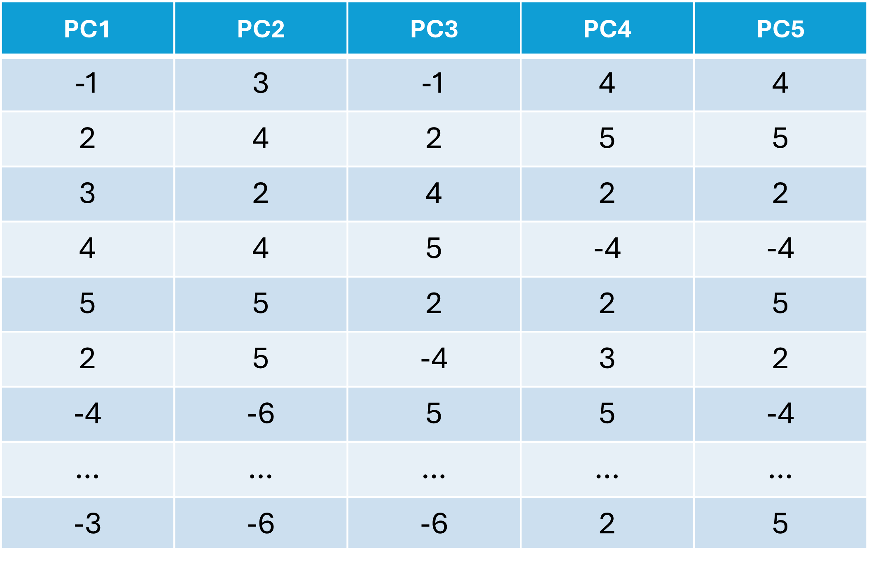
PCA
8 factors (dimensions)
5 principal Components
So, PCA took into account all of the factors and transformed them into new variables called principal components

Slide 26
PC1 | PC2 | PC3 | PC4 | PC5
0.05 | 0.14 | 0.13 | 0.11 | 0.09
0.05 | 0.12 | 0.10 | 0.15 | 0.12
0.18 | 0.10 | 0.16 | 0.09 | 0.15
0.17 | 0.18 | 0.12 | 0.13 | 0.18
0.16 | 0.16 | 0.14 | 0.14 | 0.10
0.14 | 0.08 | 0.08 | 0.08 | 0.11
0.13 | 0.07 | 0.11 | 0.10 | 0.13
0.12 | 0.15 | 0.06 | 0.10 | 0.12
0.05 | 0.14 | 0.13 | 0.11 | 0.09
And if we just take the first two components

Slide 27
PC2
PC1
We actually already see some interesting trends in our data.

Slide 28

PC1 | PC2 | PC3 | PC4 | PC5
0.05 | 0.14 | 0.13 | 0.11 | 0.09
0.05 | 0.12 | 0.10 | 0.15 | 0.12
0.18 | 0.10 | 0.16 | 0.09 | 0.15
0.17 | 0.18 | 0.12 | 0.13 | 0.18
0.16 | 0.16 | 0.14 | 0.14 | 0.10
0.14 | 0.08 | 0.08 | 0.08 | 0.11
0.13 | 0.07 | 0.11 | 0.10 | 0.13
0.12 | 0.15 | 0.06 | 0.10 | 0.12
0.05 | 0.14 | 0.13 | 0.11 | 0.09
But what about the other principal components?

Slide 29
PC1 | PC2 | PC3 | PC4 | PC5
0.05 | 0.14 | 0.13 | 0.11 | 0.09
0.05 | 0.12 | 0.10 | 0.15 | 0.12
0.18 | 0.10 | 0.16 | 0.09 | 0.15
0.17 | 0.18 | 0.12 | 0.13 | 0.18
0.16 | 0.16 | 0.14 | 0.14 | 0.10
0.14 | 0.08 | 0.08 | 0.08 | 0.11
0.13 | 0.07 | 0.11 | 0.10 | 0.13
0.12 | 0.15 | 0.06 | 0.10 | 0.12
0.05 | 0.14 | 0.13 | 0.11 | 0.09
How do we know if the first two principal components are enough to capture most of the information or variance in the dataset?

Slide 30
SCREE PLOT
Variance Explained (%)
We can use a graphical representation know as a scree plot

Slide 31
SCREE PLOT
Variance Explained (%)
A scree plot tells you how much variance of the dataset or how much information is explained by each principal component

Slide 32
SCREE PLOT
50%
Variance Explained (%)
In this case, the first principal component explains 50% of the variance in our dataset.

Slide 33
SCREE PLOT
50%
Variance Explained (%)
What this says is that 50% of the variation of a person’s lifespan can be explained by PC1

Slide 34
SCREE PLOT
50%
Variance Explained (%)
35%
If we add PC2, that is another 35% which makes 85%

Slide 35
SCREE PLOT
50%
Variance Explained (%)
35%
Adding principal components depends on our your objective but explaining 85% of variance in life expectancy sounds good.

Slide 36
SCREE PLOT
50%
Variance Explained (%)
35%
Ideally, we want to get around 90% variance with just 2 to 3 principal components so that information is retained while we can still visualize our data on a plot

Slide 37
PC2
PC1
Lastly, we also want to know which features or factors are responsible for the patterns

Slide 38
PC2
PC1
We would like to know which variables are influential and also how the variables are correlated

Slide 39
 | PC1 | PC2 | PC3 | PC4 | PC5
Height | 0.05 | 0.14 | 0.13 | 0.11 | 0.09
Weight | 0.05 | 0.12 | 0.10 | 0.15 | 0.12
Average Blood Pressure | 0.18 | 0.10 | 0.16 | 0.09 | 0.15
Average Heart Rate | 0.17 | 0.18 | 0.12 | 0.13 | 0.18
BMI | 0.16 | 0.16 | 0.14 | 0.14 | 0.10
Cholesterol Levels | 0.14 | 0.08 | 0.08 | 0.08 | 0.11
Average Cigarettes per day | 0.13 | 0.07 | 0.11 | 0.10 | 0.13
Sugar Level | 0.12 | 0.15 | 0.06 | 0.10 | 0.12
This is given by the principal component loading scores

Slide 40
 | PC1 | PC2 | PC3 | PC4 | PC5
Height | 0.05 | 0.14 | 0.13 | 0.11 | 0.09
Weight | 0.05 | 0.12 | 0.10 | 0.15 | 0.12
Average Blood Pressure | 0.18 | 0.10 | 0.16 | 0.09 | 0.15
Average Heart Rate | 0.17 | 0.18 | 0.12 | 0.13 | 0.18
BMI | 0.16 | 0.16 | 0.14 | 0.14 | 0.10
Cholesterol Levels | 0.14 | 0.08 | 0.08 | 0.08 | 0.11
Average Cigarettes per day | 0.13 | 0.07 | 0.11 | 0.10 | 0.13
Sugar Level | 0.12 | 0.15 | 0.06 | 0.10 | 0.12
Basically, each variable gets a loading score for each principal component.

Slide 41
 | PC1 | PC2 | PC3 | PC4 | PC5
Height | 0.05 | 0.14 | 0.13 | 0.11 | 0.09
Weight | 0.05 | 0.12 | 0.10 | 0.15 | 0.12
Average Blood Pressure | 0.18 | 0.10 | 0.16 | 0.09 | 0.15
Average Heart Rate | 0.17 | 0.18 | 0.12 | 0.13 | 0.18
BMI | 0.16 | 0.16 | 0.14 | 0.14 | 0.10
Cholesterol Levels | 0.14 | 0.08 | 0.08 | 0.08 | 0.11
Average Cigarettes per day | 0.13 | 0.07 | 0.11 | 0.10 | 0.13
Sugar Level | 0.12 | 0.15 | 0.06 | 0.10 | 0.12
Loading scores tells you how much it contributes or influences to that principal component.

Slide 42
 | PC1 | PC2 | PC3 | PC4 | PC5
Height | 0.05 | 0.14 | 0.13 | 0.11 | 0.09
Weight | 0.05 | 0.12 | 0.10 | 0.15 | 0.12
Average Blood Pressure | 0.18 | 0.10 | 0.16 | 0.09 | 0.15
Average Heart Rate | 0.17 | 0.18 | 0.12 | 0.13 | 0.18
BMI | 0.16 | 0.16 | 0.14 | 0.14 | 0.10
Cholesterol Levels | 0.14 | 0.08 | 0.08 | 0.08 | 0.11
Average Cigarettes per day | 0.13 | 0.07 | 0.11 | 0.10 | 0.13
Sugar Level | 0.12 | 0.15 | 0.06 | 0.10 | 0.12
For example, the loading scores in PC1 tells us that Average Blood Pressure, Average Heart Rate, BMI, Average Cigarettes per day, Cholesterol Levels and Sugar levels have high values.

Slide 43
 | PC1 | PC2 | PC3 | PC4 | PC5
Height | 0.05 | 0.14 | 0.13 | 0.11 | 0.09
Weight | 0.05 | 0.12 | 0.10 | 0.15 | 0.12
Average Blood Pressure | 0.18 | 0.10 | 0.16 | 0.09 | 0.15
Average Heart Rate | 0.17 | 0.18 | 0.12 | 0.13 | 0.18
BMI | 0.16 | 0.16 | 0.14 | 0.14 | 0.10
Cholesterol Levels | 0.14 | 0.08 | 0.08 | 0.08 | 0.11
Average Cigarettes per day | 0.13 | 0.07 | 0.11 | 0.10 | 0.13
Sugar Level | 0.12 | 0.15 | 0.06 | 0.10 | 0.12
Because they are influential or contribute a lot to PC1

Slide 44
 | PC1 | PC2 | PC3 | PC4 | PC5
Height | 0.05 | 0.14 | 0.13 | 0.11 | 0.09
Weight | 0.05 | 0.12 | 0.10 | 0.15 | 0.12
Average Blood Pressure | 0.18 | 0.10 | 0.16 | 0.09 | 0.15
Average Heart Rate | 0.17 | 0.18 | 0.12 | 0.13 | 0.18
BMI | 0.16 | 0.16 | 0.14 | 0.14 | 0.10
Cholesterol Levels | 0.14 | 0.08 | 0.08 | 0.08 | 0.11
Average Cigarettes per day | 0.13 | 0.07 | 0.11 | 0.10 | 0.13
Sugar Level | 0.12 | 0.15 | 0.06 | 0.10 | 0.12
While Height and Weight does not contribute much to PC1 because of their low loading scores.

Slide 45
Summary
PCA is used for visualization and dimensionality reduction
PCA summaries data in higher dimensions into lower dimensions by retaining as much information as possible.
PCA captures the essence of a dataset into principal components

Slide 46
Summary
The Scree Plot indicates how much variance (information) each PC holds.
Each PC are ranked by how much they explain the variation in the dataset.
Loading Scores indicate the contribution of each feature in a principal component.

Slide 47
References
https://biostatsquid.com/pca-simply-explained/

